Slide 1
Modeling Wine Preferences via Data Mining
Dev Misra

Slide 2
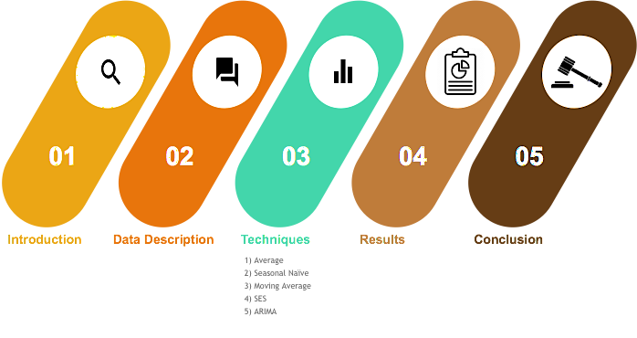
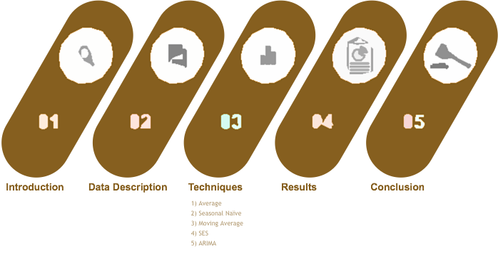
Agenda

Slide 3

Background on Wine
Wine was once viewed as a luxury good, but is now enjoyed by a wide range of consumers
Portugal is a top ten wine exporting country
Exports of Vinho Verde have increased by 36% from 1997 to 2007
Wine certifications and quality assessments are essential in the wine industry towards enhancing growth
Notes:
Once viewed as a luxury good, wine is now enjoyed by a wide range of consumers
Portugal is a top ten wine exporting countr (3.17% of the global market share in 2005)
Exports of its vinho verde wine (from the northwest region) have increased by 36% from 1997 to 2007
To support growth, the wine industry is investing in new technologies for both wine making and selling processes

Slide 4
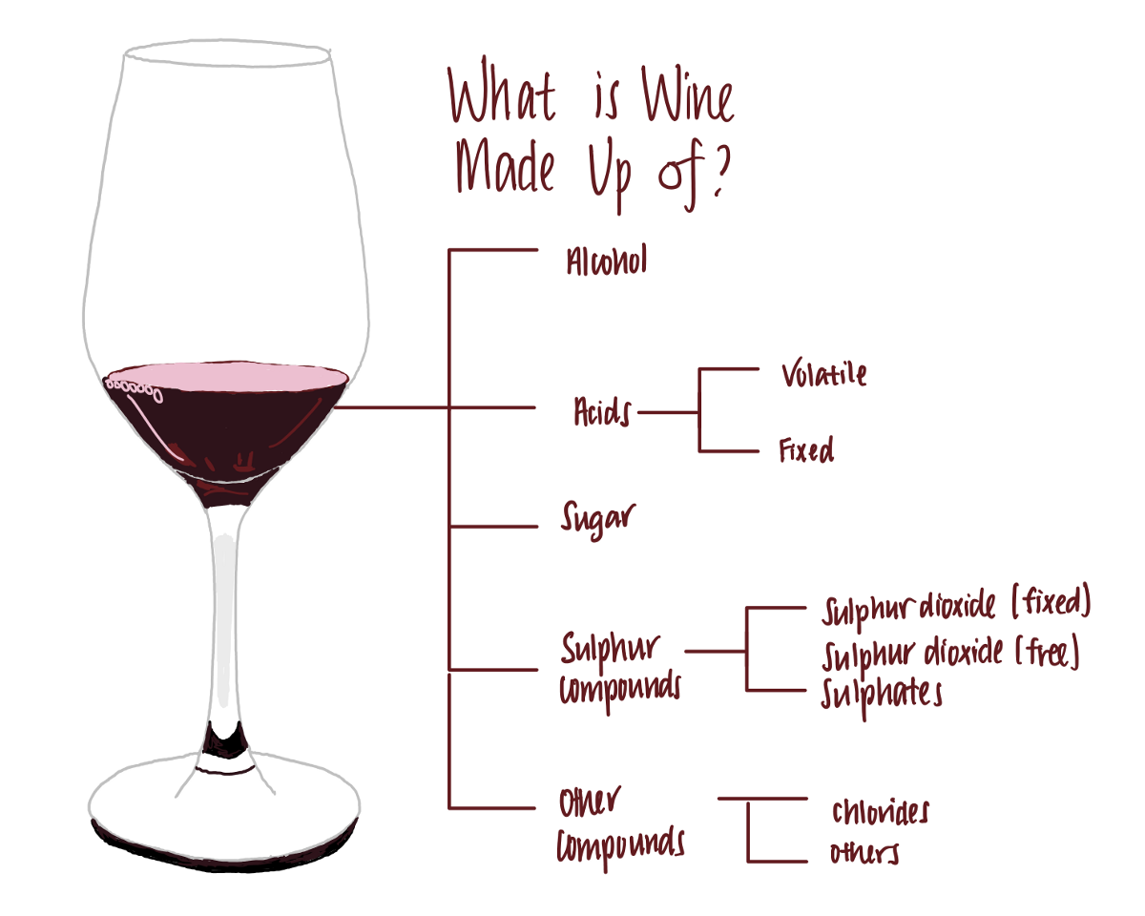
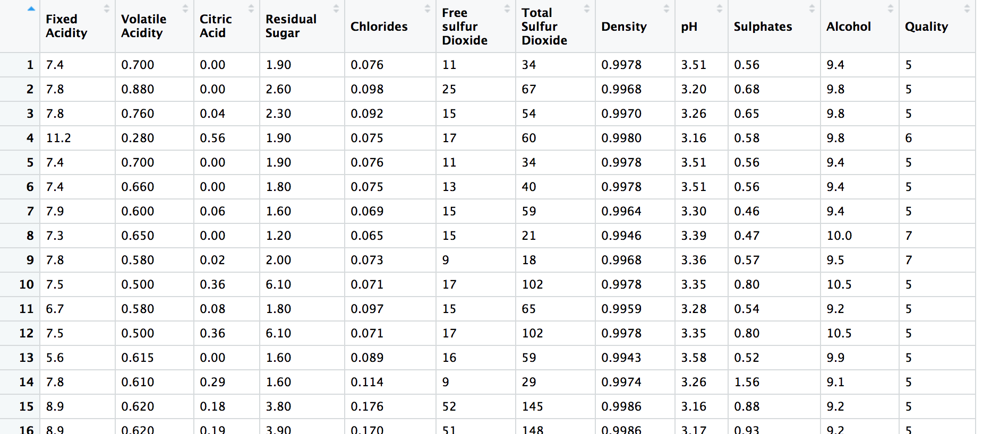
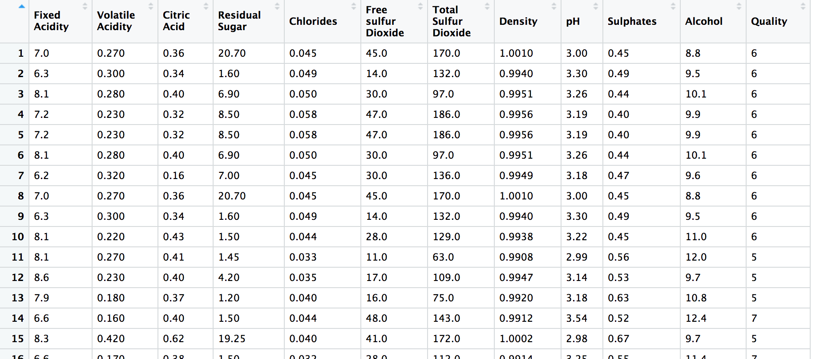
Data Description
Two large datasets, one for red wine and one for white wine
Objective
Build a model to predict wine taste preferences based on distinct variables
Red Wine
White Wine

Slide 5
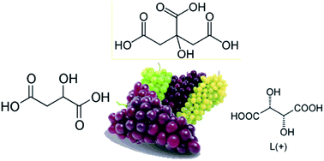
Importance of Specific Variables in Wine
Total acidity tells us the concentration of acids present in wine
Potential of hydrogen (pH) level tells us how intense these acids taste
Measures the degree of relative alkalinity of a liquid on a scale of 0 to 14, with 7 being neutral
Winemakers use pH as a way to measure ripeness in relation to acidity
Low pH wines will taste tart and crisp
Higher pH wines will taste flat and lack freshness
Most importantly, higher pH wines are more susceptible to bacterial growth, as bacteria thrive in higher pH environments

Slide 6
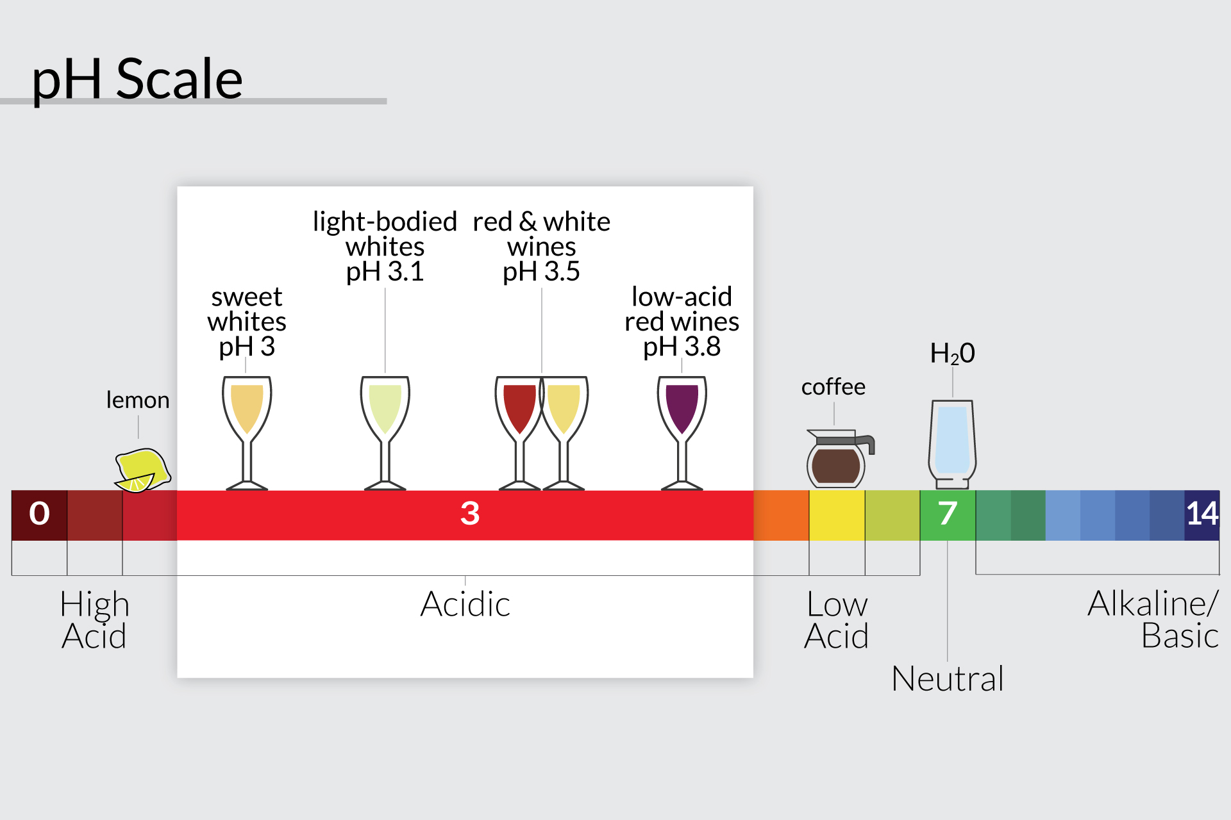

Slide 7
Ideal Acidity for Wine
Ideal pH range for red wine is 3.3 - 3.6
Ideal pH range for white wine is 3.0 - 3.4
Warmer climates result in higher sugar and lower acidity, whereas cooler climates result in lower sugar and higher acidity
In a less acidic environment, a winemaker needs to compensate with higher doses of sulfur dioxide (SO2) to keep bacteria away
E.g. a red wine with a pH of 3.9 would require about 60 mg/L of free SO2 to inhibit bacteria whereas a similar wine but with a pH of 3.2 would only require about 13 mg/L

Slide 8
How Winemakers Control for Acidity
Wines of different acidity levels can be blended to increase or lower the pH
Acid reduction using potassium bicarbonate (KHCO₃) or agents such as ACIDEX to remove acidity and raise the pH
Cold stabilization of wine can be used to increase or decrease pH
H₂O can be added to wine to dilute its acidity and increase the pH
Malolactic fermentation can raise the pH and alter the acidity of wine
Notes:
Malolactic fermentation (MLF) is a secondary fermentation caused by malolactic bacteria that converts the stronger and harsher malic acid into the softer lactic acid
MLF is not usually used to raise a wine’s pH, but rather, to make a desired style of wine, for example, a wine with softer acidity

Slide 9
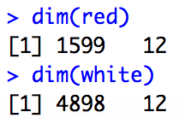
Multiple Linear Regression
Response/Dependent variable(s)
Wine Quality
Regressor/Independent variable(s):
Fixed Acidity, Volatile Acidity, Citric Acid, Residual Sugar, Chlorides, Free Sulfur Dioxide, Total Sulfur Dioxide, Density, pH, Sulphates, Alcohol
Training and Test sets
Red wine
Red training set: [1:800,]
Red test set: [801:nrow(red),]
White wine
White training set: [1:2400,]
White test set: [2401:nrow(white),]
Notes:
Total of 1599 columns for red wine data and 4898 for white wine
Separated data into training and test sets for each wine.

Slide 10
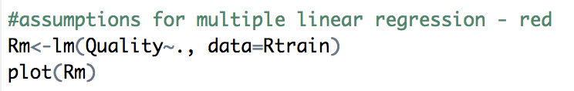
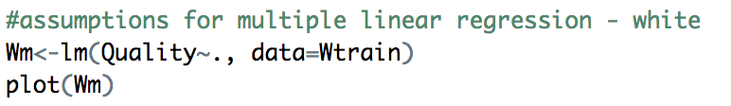
Assumptions for Regression
L.I.N.E. assumptions/conditions must be met within both datasets to draw inferences from or make predictions from the model
Linearity
Relationship between dependent and independent variables is linear
Independence of Errors
No correlation between consecutive residuals
Each independent variable can be tested using VIF values
Normality of Error
Residuals are normally distributed
Equal Variance
Residuals have a constant variance at every level of x
Notes:
There must be a linear relationship between the outcome variable and the independent variables
Scatterplots can show whether there is a linear or curvilinear relationship
No Multicollinearity – Multiple regression assumes that the independent variables are not highly correlated with each other
This assumption is tested using Variance Inflation Factor (VIF) values
Multivariate Normality – Multiple regression assumes that the residuals are normally distributed
Homoscedasticity – This assumption states that the variance of error terms are similar across the values of the independent variables
A standardized residuals versus predicted values plot can show whether points are equally distributed across all values of the independent variables

Slide 11
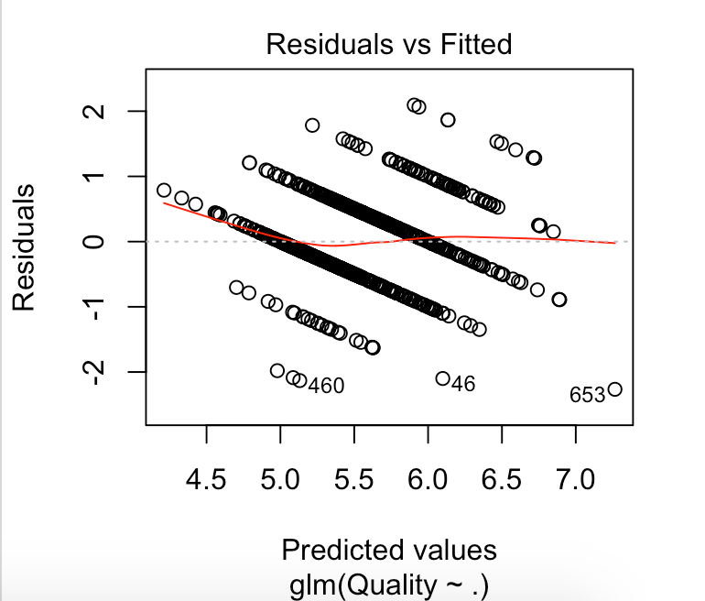
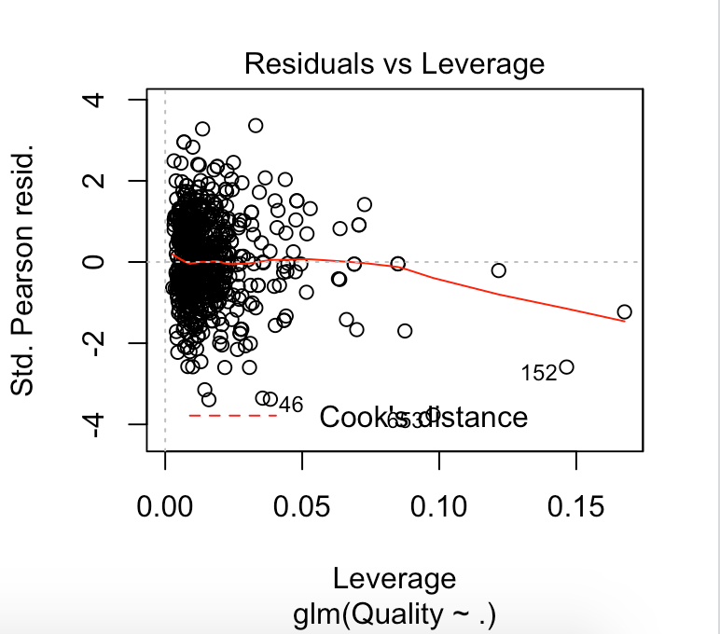
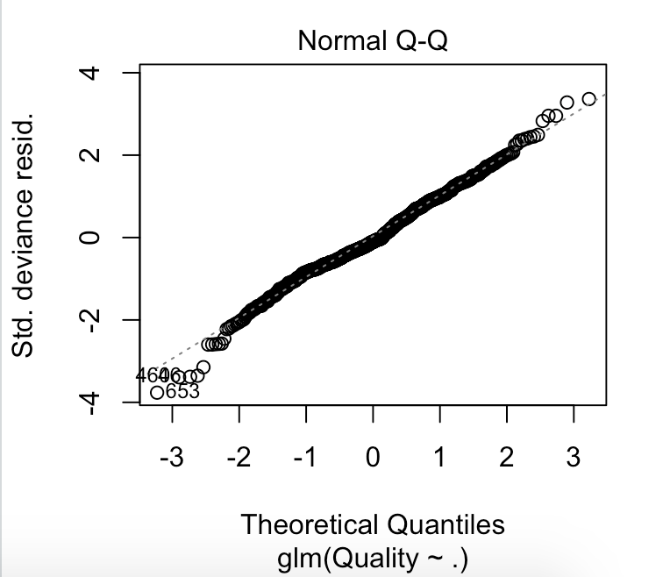
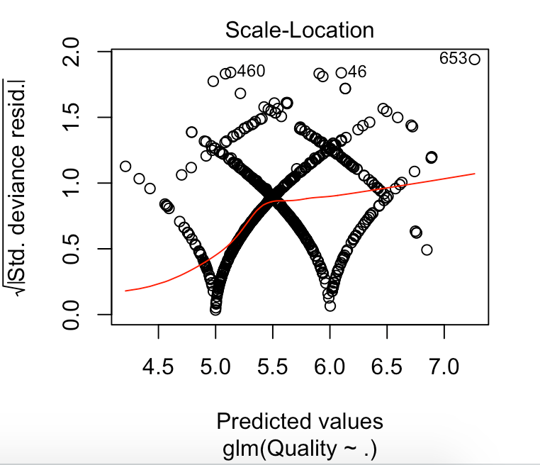
Red Wine Assumptions
Linearity
No significant U-shape in “Residuals vs Fitted”
Independence of Errors
No cyclical patterns in “Residuals vs Leverage”
Normality of Error
Residuals are normally distributed in “Normal Q-Q”
Equal Variance
Inconsistent variance in “Scale-Location”

Slide 12
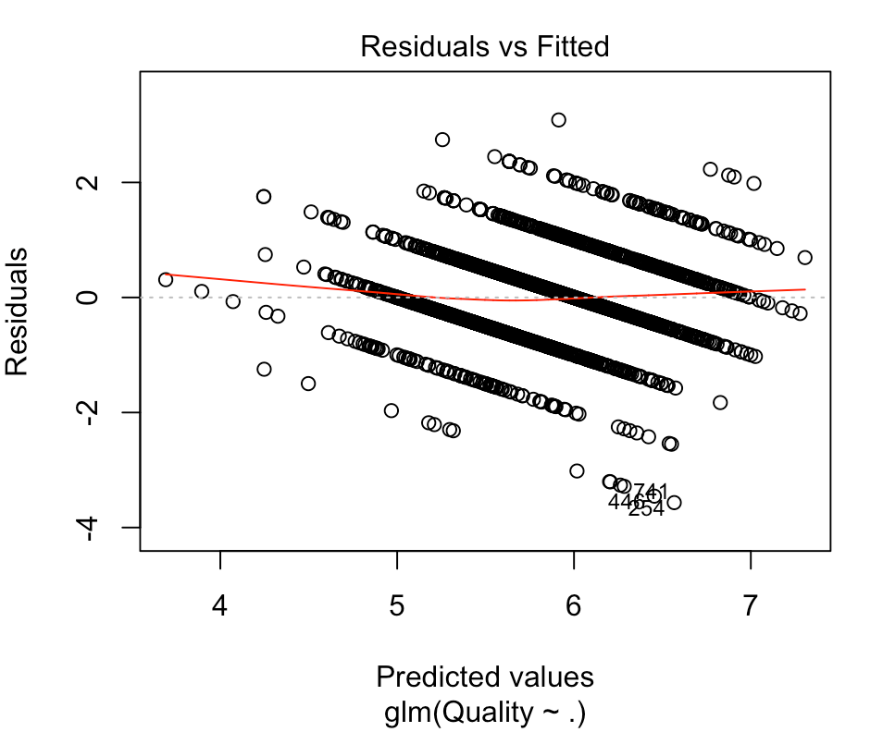
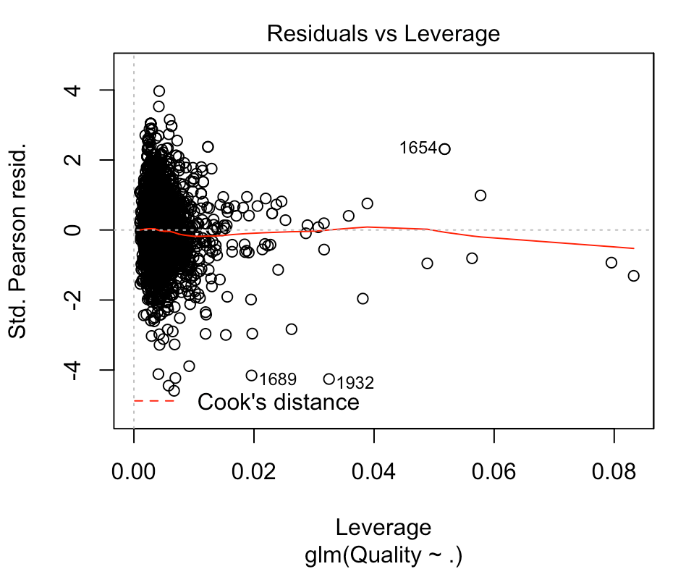
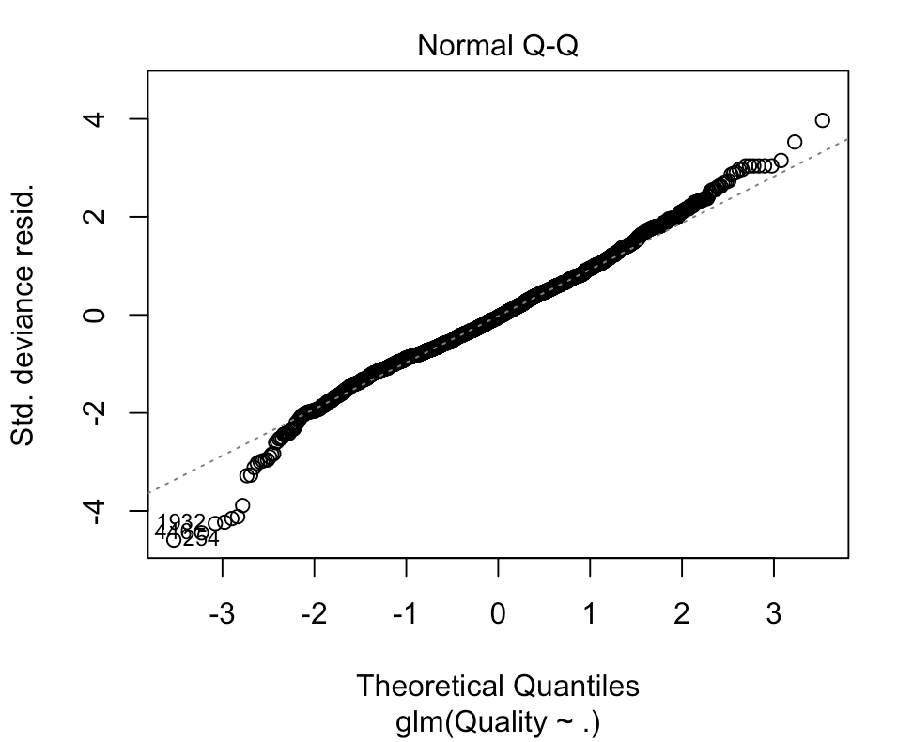
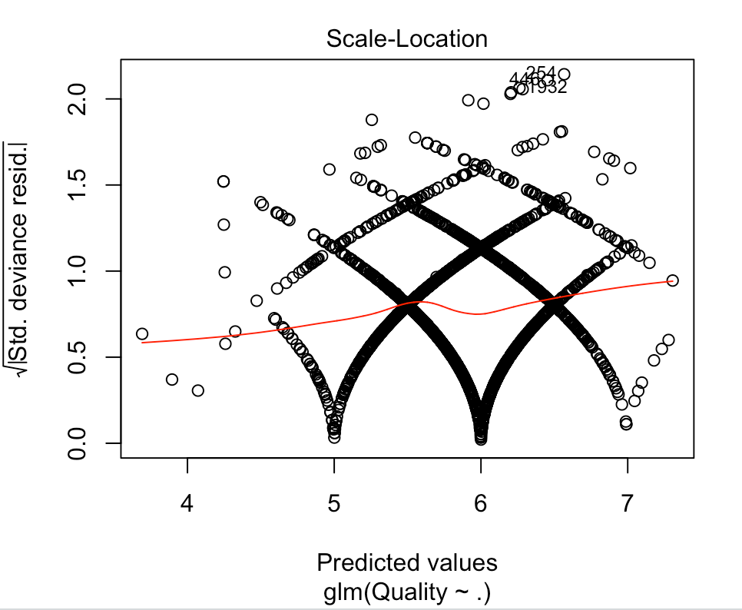
White Wine Assumptions
Linearity
No significant U-shape in “Residuals vs Fitted”
Independence of Errors
No cyclical patterns in “Residuals vs Leverage”
Normality of Error
Residuals are normally distributed in “Normal Q-Q”
Equal Variance
Inconsistent variance in “Scale-Location”

Slide 13
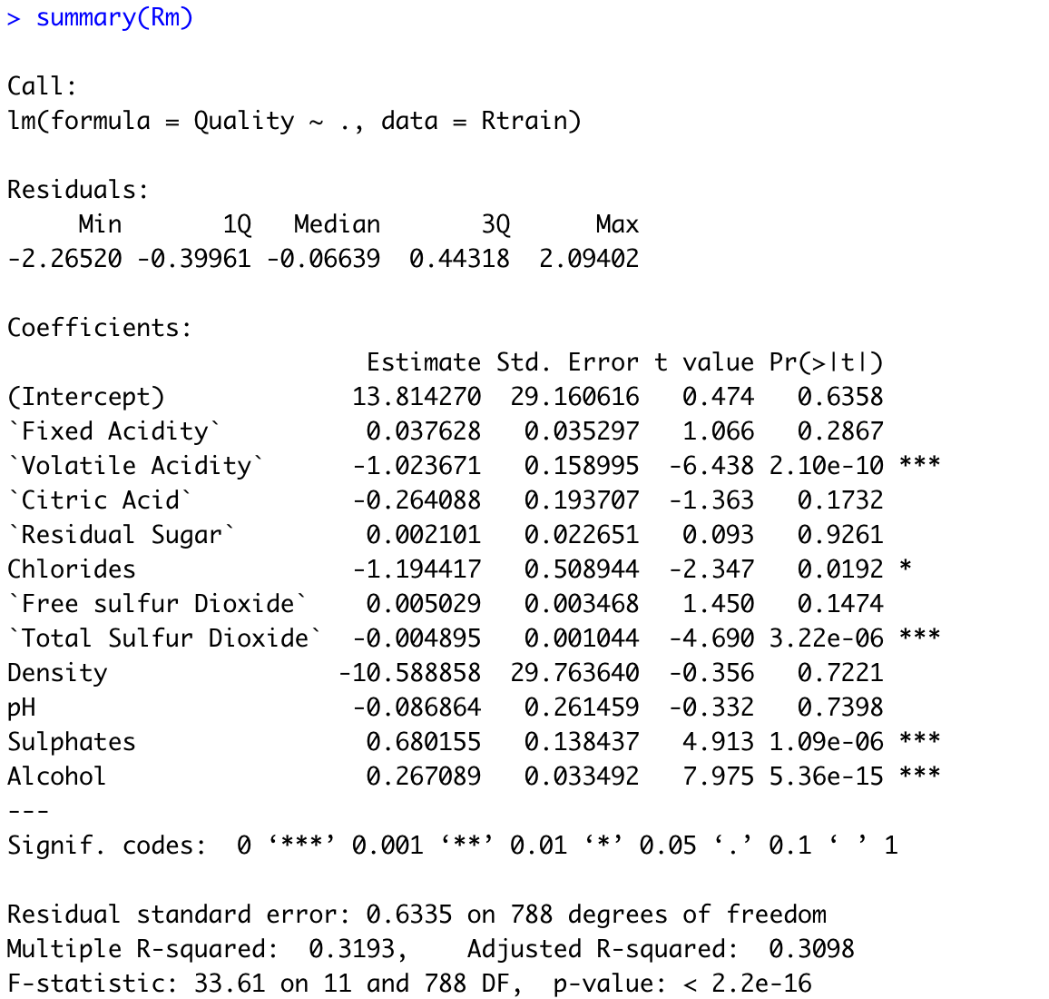
Model Fitness – Red Wine
Adjusted R-Squared: 0.3098
A low adjusted R-squared indicates that the additional input variables are not adding value to the model
Currently, the red wine model is a bad fit
Significance at α = 0.05
The model is not statistically significant at α = 0.05, as the p-value from the model is 0.6358, which is greater than 0.05
Notes:
Significance level of 0.01: The model is not statistically significant as the p-value from the F-test is greater than 0.01
Significance level of 0.05: The model is not statistically significant as the p-value from the F-test is greater than 0.05

Slide 14
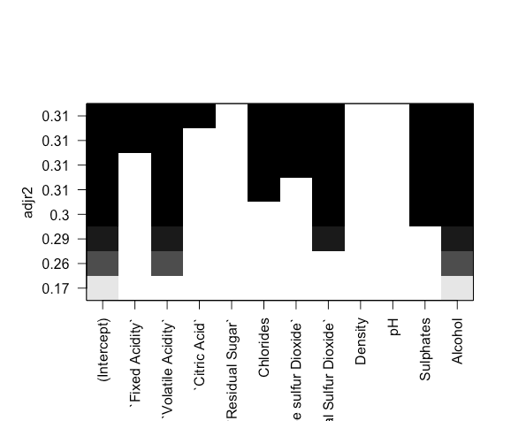
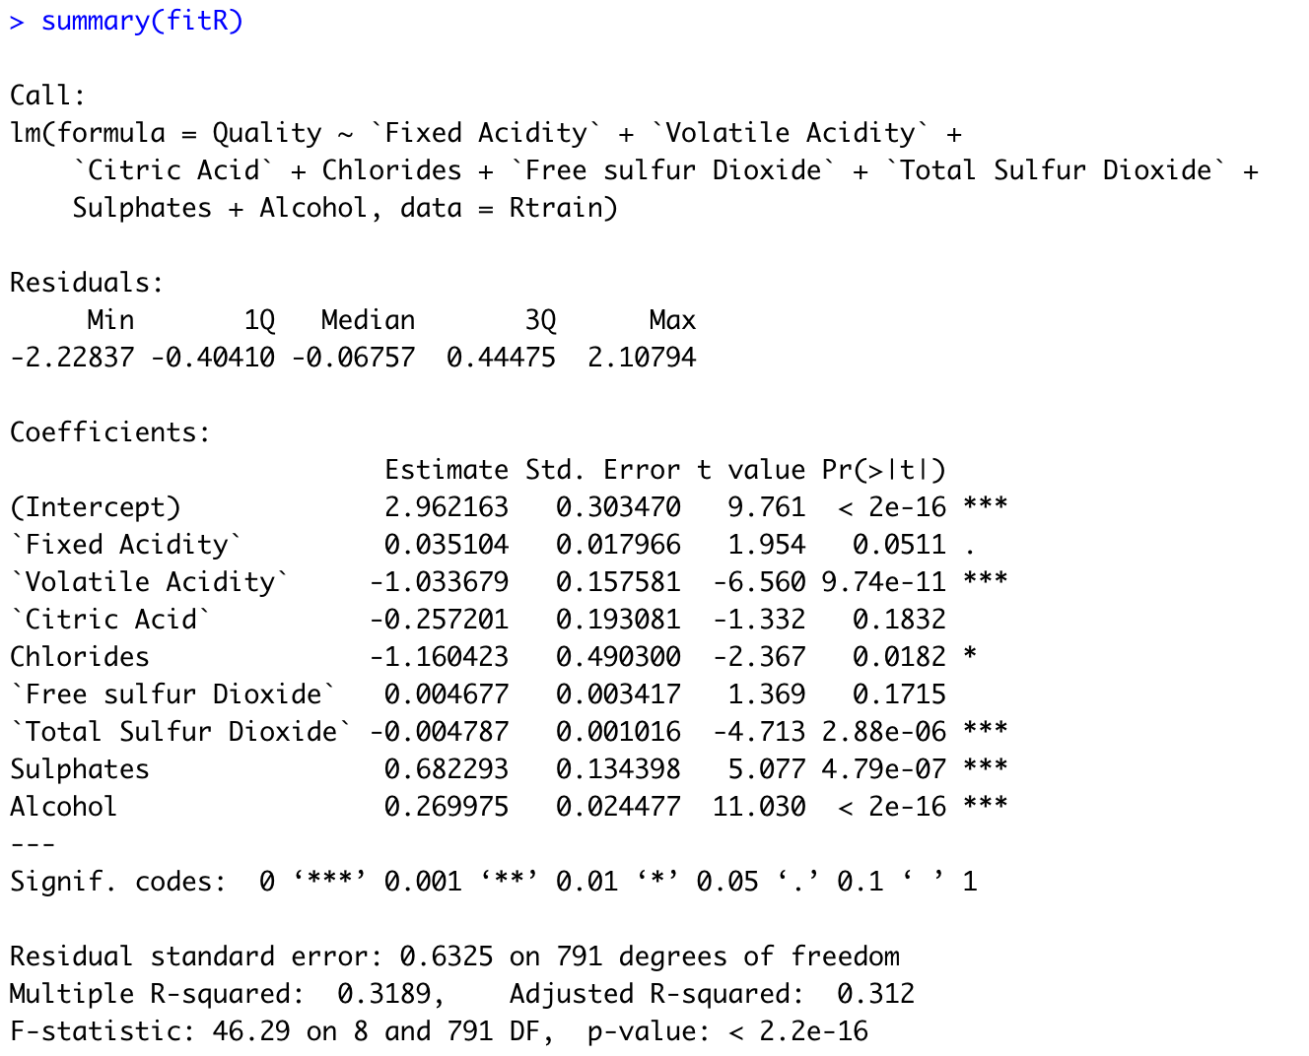
Improved Red Wine Model
Best regressor(s) to incorporate into model:
Used regsubsets {leaps}
Fixed Acidity, Volatile Acidity, Citric Acid, Chlorides, Free Sulfur Dioxide, Total Sulfur Dioxide, Sulphates, and Alcohol
Adjusted R-Squared: 0.312
Compared to the original values, the relatively higher Adjusted R-Squared indicates the regressors can add more value to the model
Significance at α = 0.05
The model is statistically significant at α = 0.05, as the p-value from the model is 2e-16, which is less than 0.05

Slide 15
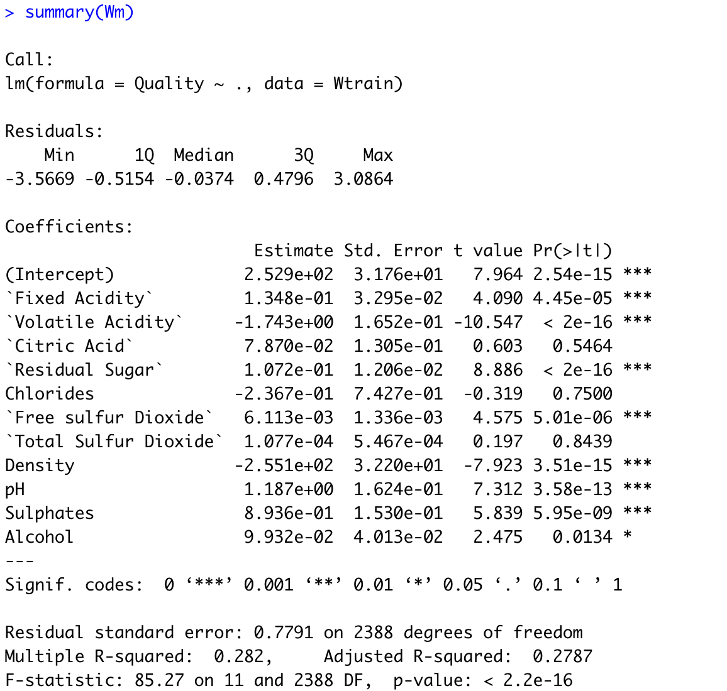
Model Fitness – White Wine
Adjusted R-Squared: 0.2787
A low adjusted R-squared indicates that the additional input variables are not adding value to the model
Currently, the white wine model is a bad fit
Significance at α = 0.05
The model is statistically significant at α = 0.05, as the p-value from the model is 2.54e-15, which is less than 0.05
Notes:
Significance level of 0.01: The model is statistically significant as the p-value from the F-test is smaller than 0.01
Significance level of 0.05: The model is statistically significant as the p-value from the F-test is smaller than 0.05

Slide 16
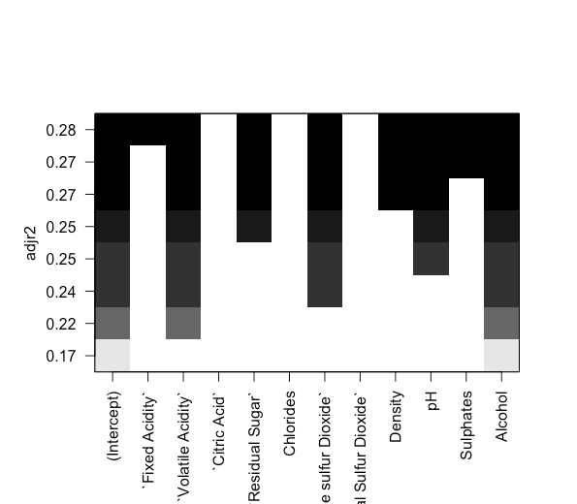
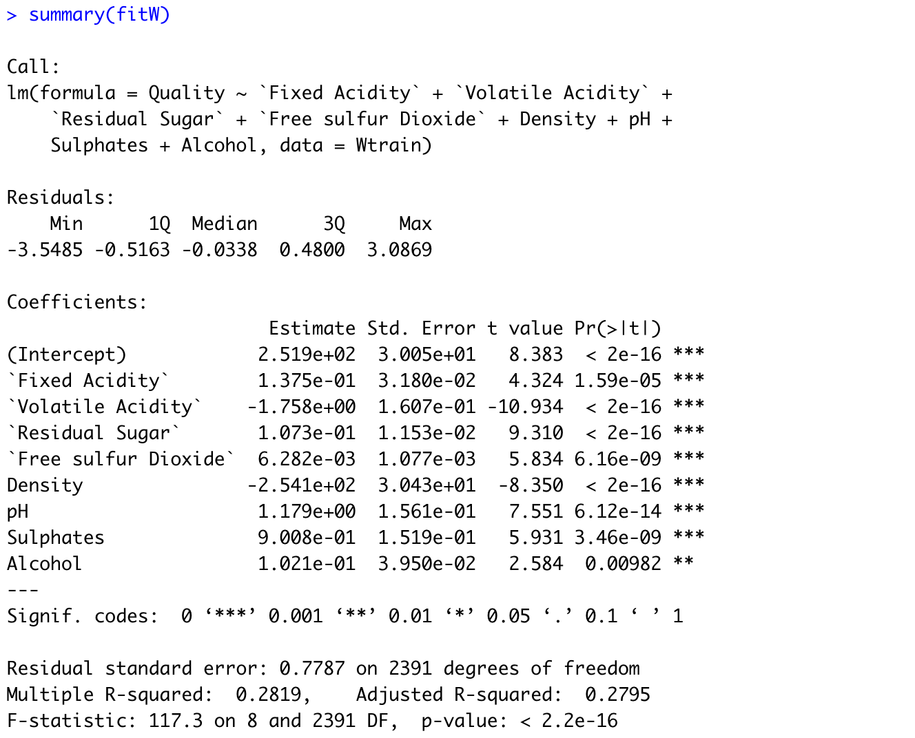
Improved White Wine Model
Best regressor(s) to incorporate into model:
Used regsubsets {leaps}
Fixed Acidity, Volatile Acidity, Residual Sugar, Free Sulfur Dioxide, Density, pH, Sulphates, and Alcohol
Adjusted R-Squared: 0.2795
Compared to the original values, the relatively higher Adjusted R-Squared indicates the regressors can add more value to the model
Significance at α = 0.05
The model is statistically significant at α = 0.05, as the p-value from the model is 2e-16, which is less than 0.05

Slide 17
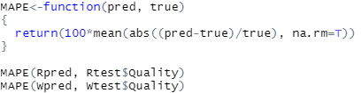
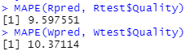
Model Evaluation
Mean Absolute Percentage Error (MAPE) is used to determine the prediction error of the models
MAPE of red wine model = 9.5976%
MAPE of white wine model = 10.3711%
Both models have a MAPE of < 10.5%, indicating that the average unsigned percentage error for each model is very low (models are good fits)
Notes:
As previously mentioned, a training set and a test set were used to test predictions
After that, the MAPE of each model was calculated to determine the prediction error
The MAPE of the red wine model was about 9.6% while the MAPE of the white whine model was about 10.4%
Incorporating more variables into the model can further increase its prediction accuracy

Slide 18
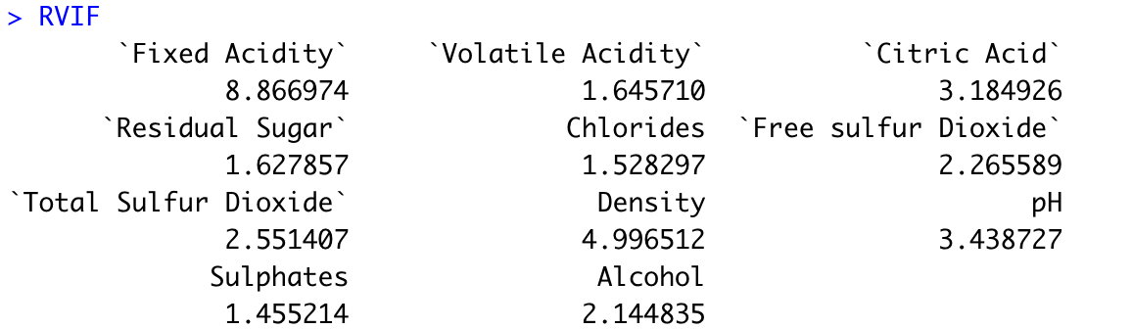
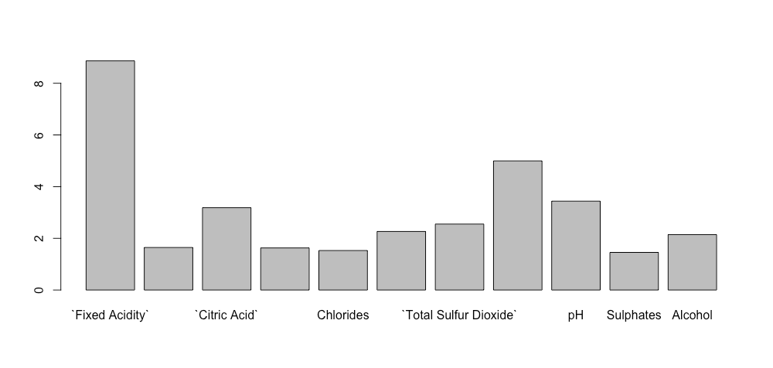
Variance Inflation Factor – Red Wine
Threshold for VIF: 5
A variable with a higher VIF contributes more to the standard error of a regression
which(RVIF>5) highlights regressors that exhibit multicollinearity
Fixed Acidity is highly collinear with the other regressors in the model
Notes:
Variance Inflation Factor (VIF) measures how much the behavior (variance) of an independent variable is influenced, or inflated, by its interaction/correlation with the other independent variables
Variance Inflation Factor (VIF) allows for a quick measurement of how much a variable contributes to the standard error of the regression
With 5 as the threshold for VIF, Fixed Acidity exhibits high multicollinearity (highest VIF among all the regressors on the bar graph and greater than threshold)

Slide 19
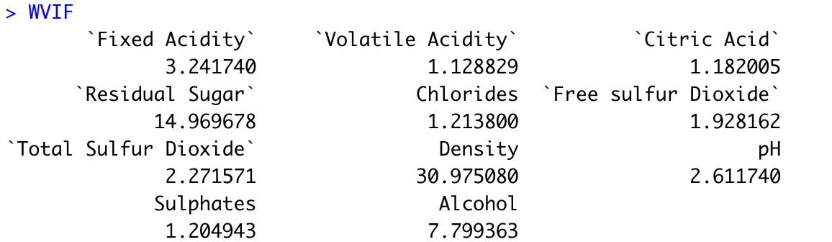
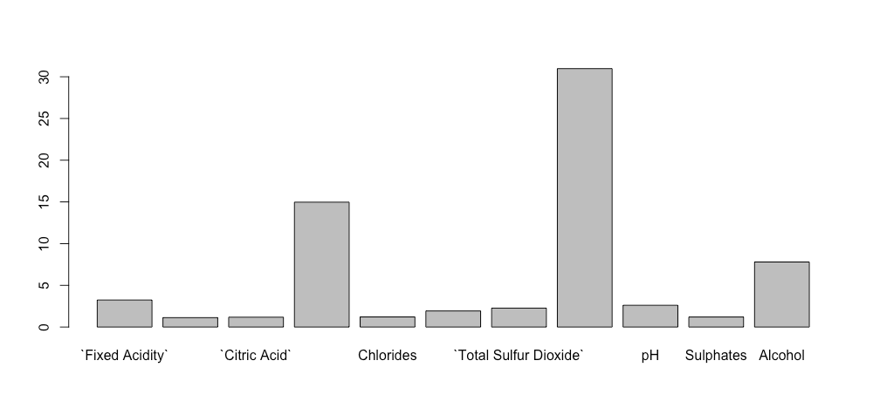
Variance Inflation Factor – White Wine
Threshold for VIF: 5
A variable with a higher VIF contributes more to the standard error of a regression
which(RVIF>5) highlights regressors that exhibit multicollinearity
Residual Sugar, Density, and Alcohol are highly collinear with the other regressors in the model
Notes:
Variance Inflation Factor (VIF) measures how much the behavior (variance) of an independent variable is influenced, or inflated, by its interaction/correlation with the other independent variables
Variance Inflation Factor (VIF) allows for a quick measurement of how much a variable contributes to the standard error of the regression
With 5 as the threshold for VIF, Density exhibits high multicollinearity (highest VIF among all the regressors on the bar graph and greater than threshold) Residual Sugar and Alcohol (respectively) also exhibit high multicollinearity (VIF greater than threshold)

Slide 20
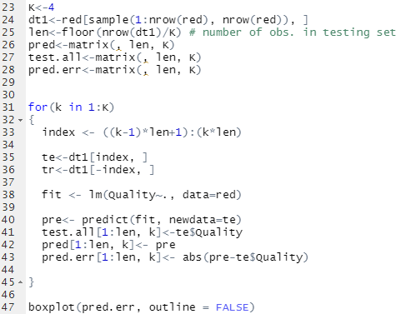
Red Wine Model Robustness (K-fold CV Test)
K-fold cross validation is a procedure used to estimate the skill of the model on new data
Four fold Cross Validation
Because the performance metrics across all four folds are similar, the red wine model can be described as robust
In other words, the model performance stays stable when the data (in both the training and test sets) changes, thus, it is robust

Slide 21
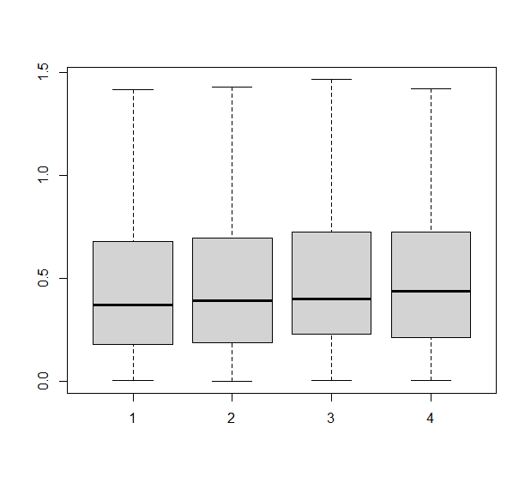
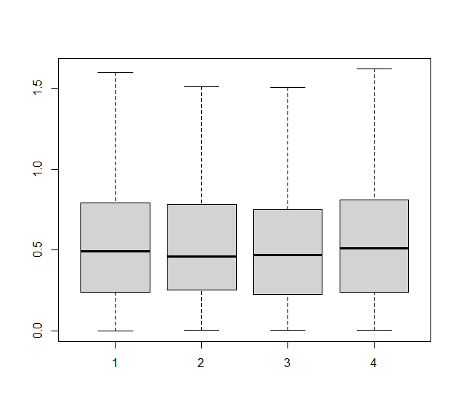
White Wine Model Robustness (K-fold CV Test)
Because the performance metrics across all four folds are similar, the white wine model can be described as robust
In other words, the model performance stays stable when the data (in both the training and test sets) changes, thus, it is robust
Red Wine
White Wine

Slide 22
Red Wine Model Conclusion
Best model (eight regressors):
(RVIF>5):
Variable(s) most important towards determining the quality of red wine:
Volatile Acidity, Citric Acid, Chlorides, Free Sulfur Dioxide, Total Sulfur Dioxide, Sulphates, and Alcohol

Slide 23
White Wine Model Conclusion
Best model (eight regressors):
(RVIF>5):
Variable(s) most important towards determining the quality of white wine:
Fixed Acidity, Volatile Acidity, Free Sulfur Dioxide, pH, and Sulphates

Slide 24
References
https://archive.ics.uci.edu/ml/datasets/Wine+Quality
https://www.sciencedirect.com/science/article/pii/S0167923609001377?via%3Dihub
https://www.restore.ac.uk/srme/www/fac/soc/wie/research-new/srme/modules/mod3/3/index.html
https://www.wineperspective.com/wine-acidity/
https://winemakermag.com/technique/1650-monitoring-adjusting-ph
https://winemakermag.com/article/547-phiguring-out-ph
https://www.statisticssolutions.com/assumptions-of-multiple-linear-regression/

Slide 25
THANK YOU

